Slide 1
CRYSTAL IMPERFECTIONS

Slide 2
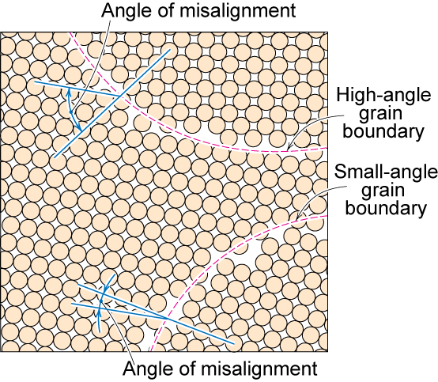
Polycrystalline Materials
Grain Boundaries
regions between crystals
transition from lattice of one region to that of the other
slightly disordered
low density in grain boundaries
  high mobility
  high diffusivity
  high chemical reactivity
Adapted from Fig. 4.7, Callister & Rethwisch 8e.

Slide 3
Imperfections in Solids
There is no such thing as a perfect crystal.
What are these imperfections?
Why are they important?
Many of the important properties of materials are due to the presence of imperfections.

Slide 4
Types of Imperfections
• Vacancy atoms
• Interstitial atoms
• Substitutional atoms
Point defects
• Dislocations
Line defects
• Grain Boundaries
Area defects

Slide 5
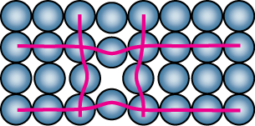
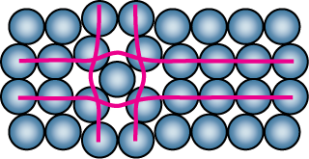
Point Defects in Metals
• Vacancies:
-vacant atomic sites in a structure.
Vacancy
distortion
of planes
• Self-Interstitials:
-"extra" atoms positioned between atomic sites.
self-
interstitial
distortion
of planes

Slide 6
Equilibrium Concentration:
Point Defects
• Equilibrium concentration varies with temperature!
No. of defects
Activation energy
N
⎛
−
Q
⎞
v
=
exp
⎜
v
⎟
No. of potential
N
⎝
k
T
⎠
defect sites
Temperature
Boltzmann's constant
(1.38 x 10
-23
J/atom-K)
(8.62
x
10
-5
eV/atom-K)
Each lattice site
is a potential
vacancy site

Slide 7
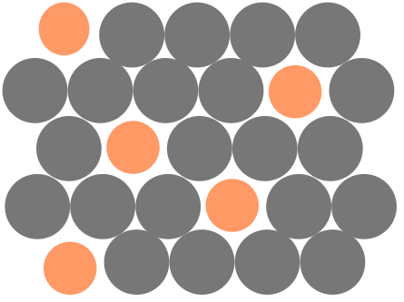
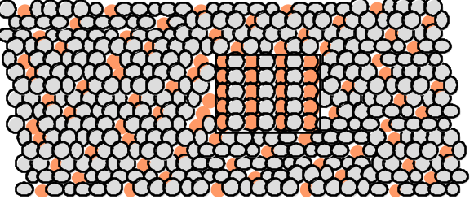
Imperfections in Metals (i)
Two outcomes if impurity (B) added to host (A):
• Solid solution of B in A (i.e., random dist. of point defects)
OR
Substitutional solid soln.
(e.g., Cu in Ni)
Interstitial solid soln.
(e.g., C in Fe)
• Solid solution of B in A plus particles of a new
phase (usually for a larger amount of B)
Second phase particle
-- different composition
-- often different structure.

Slide 8
Imperfections in Metals (ii)
Conditions for substitutional solid solution (S.S.)
W. Hume – Rothery rule
  1. Δr (atomic radius) < 15%
  2. Proximity in periodic table
    i.e., similar electronegativities
  3. Same crystal structure for pure metals
  4. Valency
    All else being equal, a metal will have a greater tendency to dissolve a metal of higher valency than one of lower valency

Slide 9
Line Defects
Dislocations:
• are line defects,
• slip between crystal planes result when dislocations move,
• produce permanent (plastic) deformation.
Schematic of Zinc (HCP):
• before deformation
• after tensile elongation
slip steps

Slide 10
Imperfections in Solids
Linear Defects (Dislocations)
  Are one-dimensional defects around which atoms are misaligned
Edge dislocation:
  extra half-plane of atoms inserted in a crystal structure
  b perpendicular (⊥) to dislocation line
Screw dislocation:
  spiral planar ramp resulting from shear deformation
  b parallel (||) to dislocation line
Burger’s vector, b: measure of lattice distortion

Slide 11
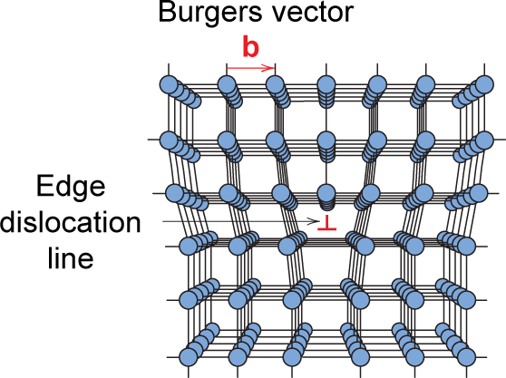
Imperfections in Solids
Edge Dislocation
Fig. 4.3, Callister & Rethwisch 8e.

Slide 12
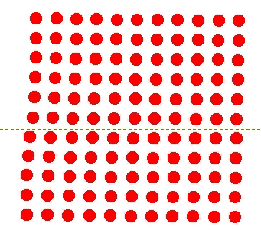
Motion of Edge Dislocation
• Dislocation motion requires the successive bumping
of a half plane of atoms (from left to right here).
• Bonds across the slipping planes are broken and
remade in succession.
Atomic view of edge
dislocation motion from
left to right as a crystal
is sheared.
Click once on image to start animation
(Courtesy P.M. Anderson)

Slide 13
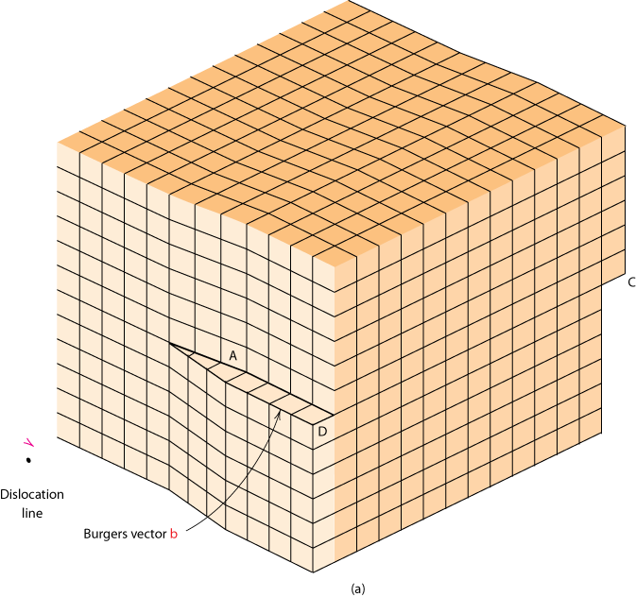
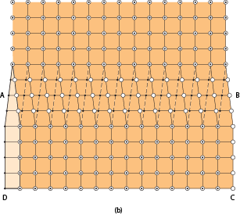
Imperfections in Solids
Screw Dislocation
Screw Dislocation
Dislocation
line
b
Burgers vector b
(b)
(a)
Adapted from Fig. 4.4, Callister & Rethwisch 8e.

Slide 14
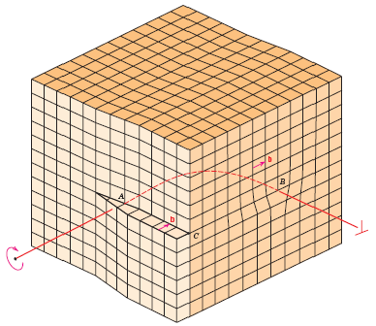
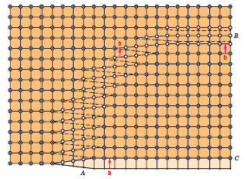
Edge, Screw, and Mixed Dislocations
Mixed
Edge
Screw
Adapted from Fig. 4.5, Callister & Rethwisch 8e.

Slide 15
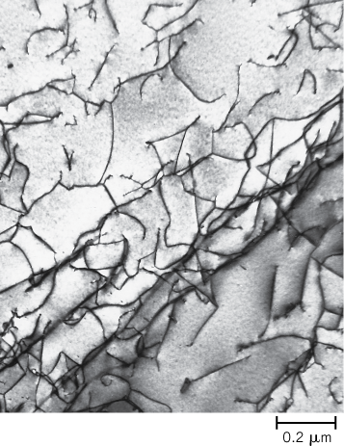
Imperfections in Solids
Dislocations are visible in electron micrographs
Fig. 4.6, Callister & Rethwisch 8e.

Slide 16
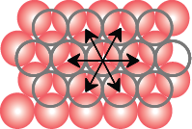
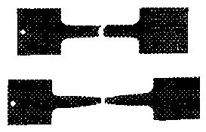
Dislocations & Crystal Structures
• Structure: close-packed
planes & directions
are preferred.
view onto two
close-packed
planes.
close-packed directions
close-packed plane (bottom)
close-packed plane (top)
• Comparison among crystal structures:
FCC: many close-packed planes/directions;
HCP: only one plane, 3 directions;
BCC: none
• Specimens that
were tensile
tested.
Mg (HCP)
tensile direction
Al (FCC)

Slide 17
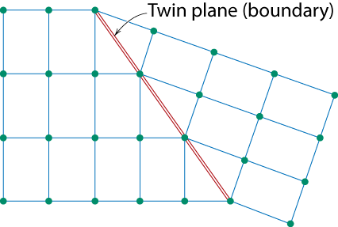
Planar Defects in Solids
One case is a twin boundary (plane)
  Essentially a reflection of atom positions across the twin plane.
Stacking faults
  For FCC metals an error in ABCABC packing sequence
  Ex: ABCABABC
Adapted from Fig. 4.9, Callister & Rethwisch 8e.

Slide 18
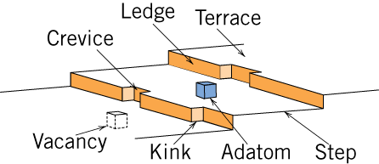
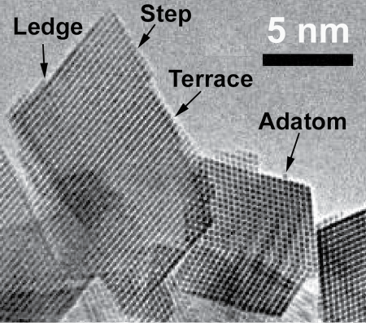
Catalysts and Surface Defects
A catalyst increases the rate of a chemical reaction without being consumed
Active sites on catalysts are normally surface defects
Fig. 4.10, Callister & Rethwisch 8e.
Single crystals of (Ce_{0.5}Zr_{0.5})O₂
used in an automotive catalytic converter
Fig. 4.11, Callister & Rethwisch 8e.

Slide 19
Microscopic Examination
Crystallites (grains) and grain boundaries. Vary considerably in size. Can be quite large.
  ex: Large single crystal of quartz or diamond or Si
  ex: Aluminum light post or garbage can - see the individual grains
Crystallites (grains) can be quite small (mm or less) – necessary to observe with a microscope.

Slide 20
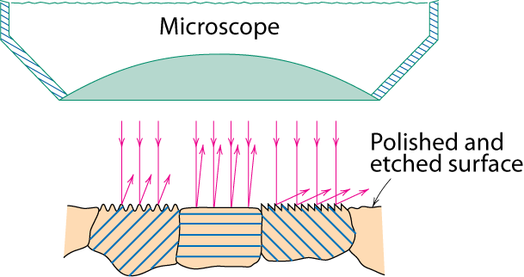
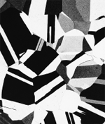
Optical Microscopy
• Useful up to 2000X magnification.
• Polishing removes surface features (e.g., scratches)
• Etching changes reflectance, depending on crystal
orientation.
crystallographic planes
Adapted from Fig. 4.13(b) and (c), Callister & Rethwisch 8e. (Fig. 4.13(c) is courtesy
of J.E. Burke, General Electric Co.)
Micrograph of
brass (a Cu-Zn alloy)
0.75mm

Slide 21
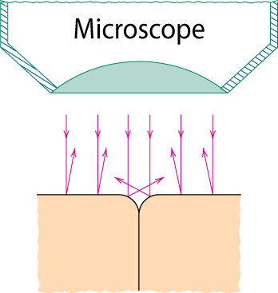
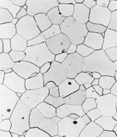
Optical Microscopy
Grain boundaries...
• are imperfections,
• are more susceptible
to etching,
• may be revealed as
dark lines,
• change in crystal
orientation across
boundary.
polished surface
surface groove
grain boundary
(a)
Adapted from Fig. 4.14(a) and (b), Callister & Rethwisch 8e.
(Fig. 4.14(b) is courtesy
of L.C. Smith and C. Brady, the National Bureau of Standards, Washington, DC [now the National Institute of Standards and Technology, Gaithersburg, MD].)
ASTM grain
size number
N
= 2
n
-1
Fe-Cr alloy
number of grains/in²
at 100x
(b)
magnification

Slide 22
Summary
• Point, Line, and Area defects exist in solids.
• The number and type of defects can be varied
and controlled (e.g., T controls vacancy conc.)
• Defects affect material properties (e.g., grain
boundaries control crystal slip).
• Defects may be desirable or undesirable
(e.g., dislocations may be good or bad, depending
on whether plastic deformation is desirable or not.)

